Slide 1

Level: Basic
Game Development with Unity
Omid Saadat

Slide 2

I want to develop a game!
What is a Game Engine?
Why Unity?

Slide 3
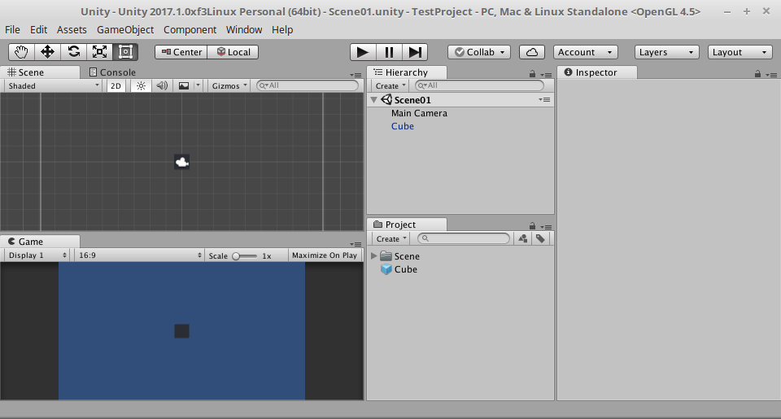
Interface

Slide 4
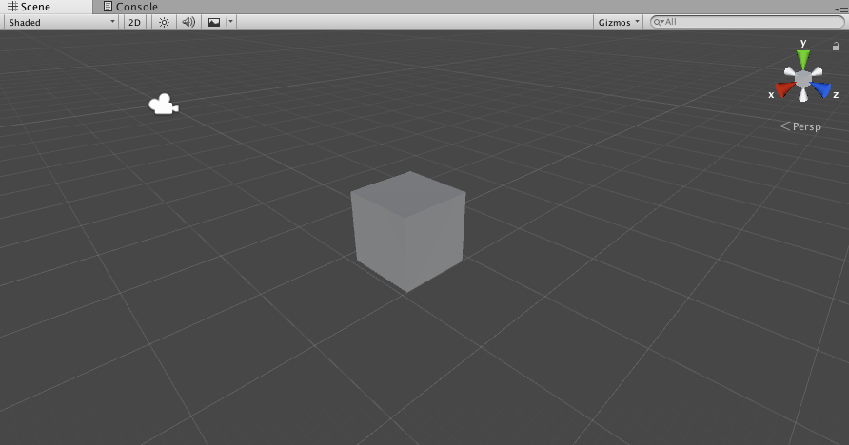
Navigation in Scene View
Middle Mouse Button: Pan
Middle Mouse Scroll: Zoom
Right Mouse Button : (3D)Look/(2D)Pan
Left Mouse Button: Select (Drag to select Area)
(3D Only)Right Mouse Button + WASD: Fly throw

Slide 5

Top Menu (Important)
File → Build Setting
Edit → Preference
Edit → Project Setting
Edit → Snap Setting
Asset → Create
Asset → Select Dependencies
GameObject (Later)
Components (Later)
Window

Slide 6
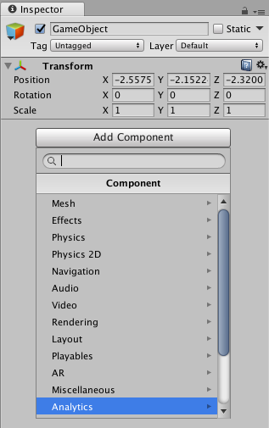
GameObjects and Components
What is an Asset?
What is a GameObject?
What is a Scene?
What are Components?

Slide 7
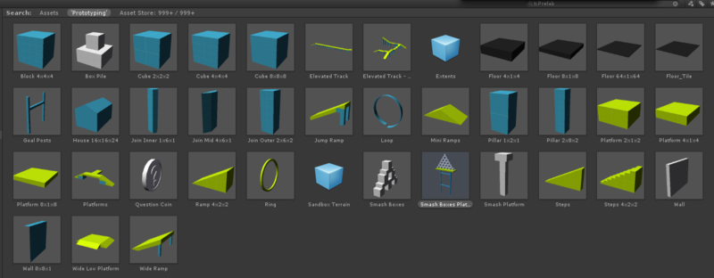
Import Assets
Textures
Audio
3D Models
…

Slide 8


Particles
Let the fun begins!

Slide 9
Prefabs
What is a prefab?
How to use prefabs?
Best practices:
  Link Prefabs
  Pack related objects
  Instantiate
  Packing without some components!

Slide 10
Start Coding in unity
IDE
Who is this MonoBehaviour?
PreDefined MonoBehaviour Methods: Awake – Start – OnEnable - …
What else?
  Instantiate
  GetComponent
  AddComponent
  Destroy
  ...

